Slide 1
Chapter 3 Information Retrieval
Information Processing Technology
of Internet of Things
WU LIU
Beijing Key Lab of Intelligent Telecomm. Software and Multimedia
Beijing University of Posts and Telecommunications

Slide 2
3.1 Introduction

Slide 3
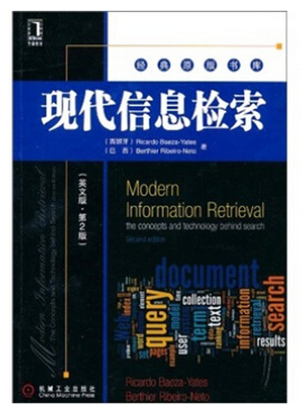

Modern Information Retrieval-The Concepts and Technology behind Search (second edition). Ricardo Baeza-Yates, Berthier Ribeiro-Neto

Slide 4
Information Retrieval (IR)
IR deals with the representation, storage, organization of, and access to information items
Types of information items: documents, Web pages, online catalogs, structured records, multimedia objects
Early goals of the IR area: indexing text and searching for useful documents in a collection
Nowadays, research in IR includes:
Modeling, Web search, text classification, systems architecture, user interfaces, data visualization, filtering and languages

Slide 5
Early Developments
For more than 5,000 years, man has organized information for later retrieval and searching
This has been done by compiling, storing, organizing, and indexing papyrus, hieroglyphics, and books
For holding the various items, special purpose buildings called libraries, are used
Nowadays, libraries are everywhere
Since the volume of information in libraries is always growing, it is necessary to build specialized data structures for fast search — the indexes
For centuries indexes have been created manually as sets of categories, with labels associated with each category
The advent of modern computers has allowed the construction of large indexes automatically

Slide 6
Libraries and Digital Libraries
Libraries were among the first institutions to adopt IR systems for retrieving information
Initially, such systems consisted of an automation of existing processes such as card catalogs searching
Increased search functionality was then added
Ex: subject headings, keywords, query operators
Nowadays, the focus has been on improved graphical interfaces, electronic forms, hypertext features

Slide 7
IR at the Center of the Stage
Until recently, IR was an area of interest restricted mainly to librarians and information experts
The fact changed these perceptions—the introduction of the Web, which has become the largest repository of knowledge in human history, and IoT, which will be the largest repository of information gathered from physical world.
Due to its enormous size, finding useful information on the information repository usually requires running a search
Thus, almost overnight, IR has gained a place with other technologies at the center of the stage

Slide 8
The IR Problem
Users of modern IR systems, such as search engine users, have information needs of varying complexity
An example of complex information need is as follows:
Find all documents that address the role of the Federal Government in financing the operation of the National Railroad Transportation Corporation (AMTRAK)
This full description of the user information need is not necessarily a good query to be submitted to the IR system
Instead, the user might want to first translate this information need into a query

Slide 9
The IR Problem
This translation process yields a set of keywords, or index terms, which summarize the user information need
Given the user query, the key goal of the IR system is to retrieve information that is useful or relevant to the user
That is, the IR system must rank the information items according to a degree of relevance to the user query
The IR Problem
The key goal of an IR system is to retrieve all the items that are relevant to a user query, while retrieving as few nonrelevant items as possible
The notion of relevance is of central importance in IR

Slide 10
The User’s Task
Consider a user who seeks information on a topic of their interest
This user first translates their information need into a query, which requires specifying the words that compose the query
In this case, we say that the user is searching or querying for information of their interest
Consider now a user who has an interest that is either poorly defined or inherently broad
For instance, the user has an interest in car racing and wants to browse documents on Formula 1 and Formula Indy
In this case, we say that the user is browsing or navigating the documents of the collection

Slide 11
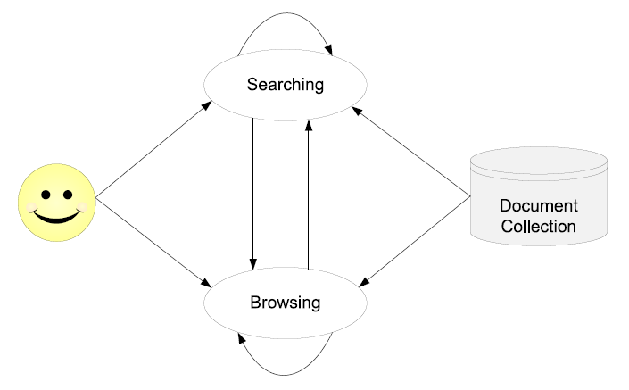
The User’s Task

Slide 12
Information vs Data Retrieval
Data retrieval: the task of determining which documents of a collection contain the keywords in the user query
Data retrieval system
Ex: relational databases
Deals with data that has a well defined structure and semantics
A single erroneous object among a thousand retrieved objects means total failure
Data retrieval does not solve the problem of retrieving information about a subject or topic

Slide 13
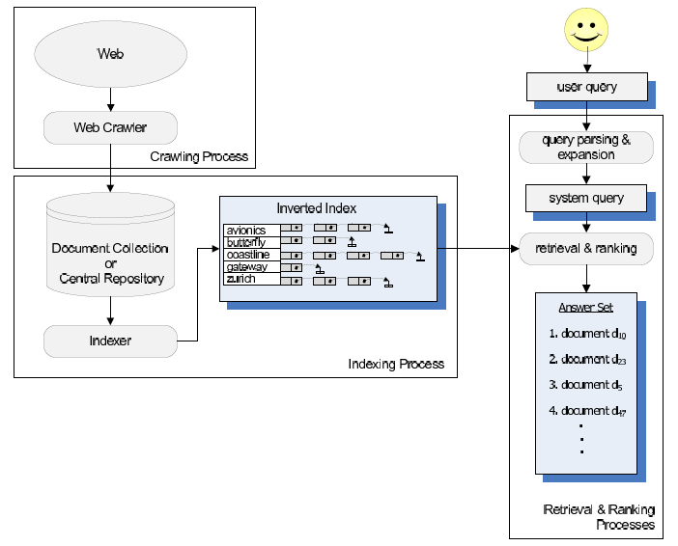
Architecture of the IR System
High level software architecture of an IR system

Slide 14
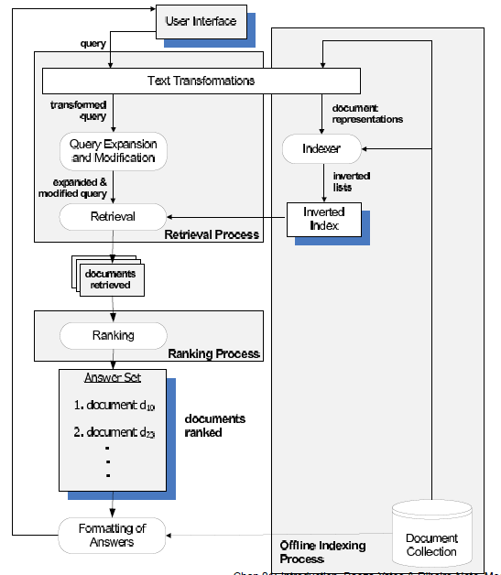
Retrieval and Ranking Processes
The processes of indexing, retrieval, and ranking

Slide 15
3.2 Modeling

Slide 16
IR Models
Modeling in IR is a complex process aimed at producing a ranking function
Ranking function: a function that assigns scores to documents with regard to a given query
This process consists of two main tasks:
The conception of a logical framework for representing documents and queries
The definition of a ranking function that allows quantifying the similarities among documents and queries

Slide 17
Modeling and Ranking
IR systems usually adopt index terms to index and retrieve documents
Index term:
In a restricted sense: it is a keyword that has some meaning on its own; usually plays the role of a noun
In a more general form: it is any word that appears in a document
Retrieval based on index terms can be implemented efficiently
Also, index terms are simple to refer to in a query
Simplicity is important because it reduces the effort of query formulation

Slide 18
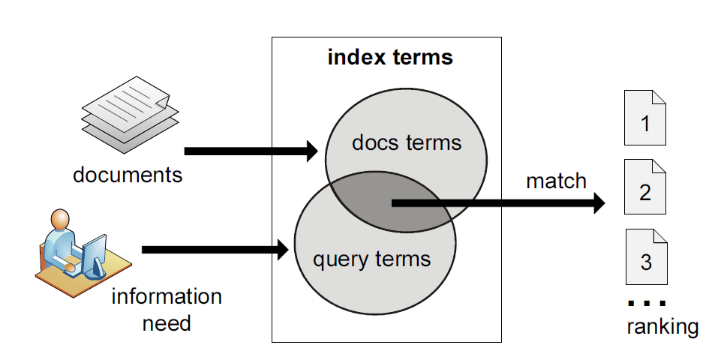
Information retrieval process

Slide 19
Introduction
A ranking is an ordering of the documents that (hopefully) reflects their relevance to a user query
Thus, any IR system has to deal with the problem of predicting which documents the users will find relevant
This problem naturally embodies a degree of uncertainty, or vagueness

Slide 20
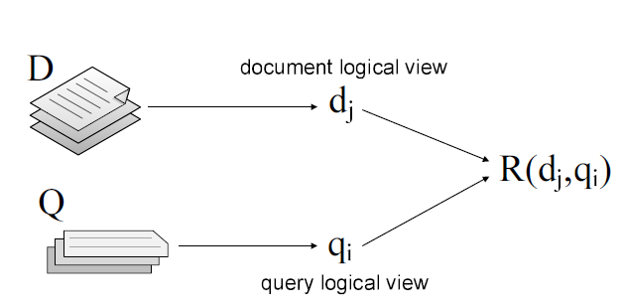
IR Models
An IR model is a quadruple [D, Q, F, R(qi, dj)] where
1. D is a set of logical views for the documents in the collection
2. Q is a set of logical views for the user queries
3. F is a framework for modeling documents and queries
4. R(qi, dj) is a ranking function

Slide 21
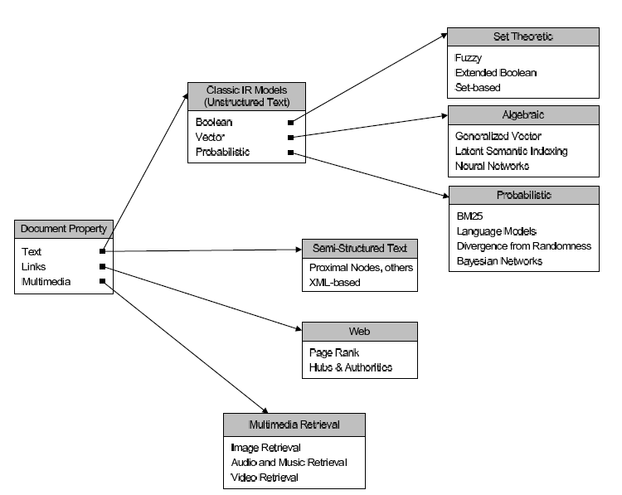
A Taxonomy of IR Models

Slide 22
Basic Concepts
Each document is represented by a set of representative keywords or index terms
An index term is a word or group of consecutive words in a document
A pre-selected set of index terms can be used to summarize the document contents, representing key concepts or topics of the document
However, it might be interesting to assume that all words are index terms (full text representation)

Slide 23

Basic Concepts
Let,
t be the number of index terms in the document collection
ki be a generic index term
Then,
The vocabulary V = {k1, . . . , kt} is the set of all distinct index terms in the collection

Slide 24
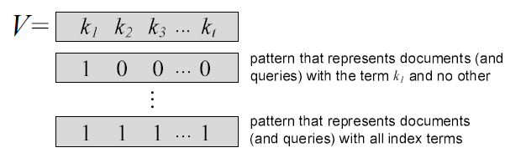
Basic Concepts
Documents and queries can be represented by patterns of term co-occurrences
Each of these patterns of term co-occurence is called a term conjunctive component
For each document dj (or query q) we associate a unique term conjunctive component c(dj) (or c(q))

Slide 25
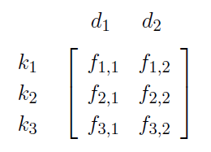
The Term-Document Matrix
The occurrence of a term ki in a document dj establishes a relation between ki and dj
A term-document relation between ki and dj can be quantified by the frequency of the term in the document
In matrix form, this can written as
where each fi,j element stands for the frequency of term ki in document dj

Slide 26
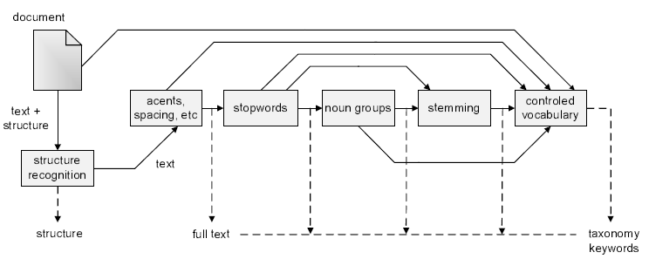
Basic Concepts
Logical view of a document: from full text to a set of index terms

Slide 27
3.2.1 The Boolean Model

Slide 28

The Boolean Model
Simple model based on set theory and boolean algebra
Queries specified as boolean expressions
quite intuitive and precise semantics
neat formalism
example of query
Term-document frequencies in the term-document matrix are all binary
Wij {0, 1}: weight associated with pair (ki, dj)
wiq {0, 1}: weight associated with pair (ki, q)

Slide 29

The Boolean Model
A term conjunctive component that satisfies a query q is called a query conjunctive component c(q)
A query q rewritten as a disjunction of those components is called the disjunct normal form qDNF
To illustrate, consider
Query
Vocabulary
Then

Slide 30

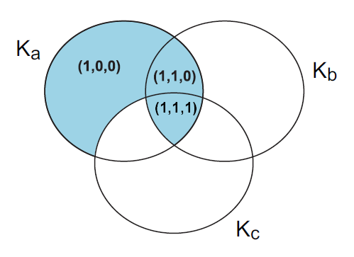
The Boolean Model
The three conjunctive components for the query

Slide 31


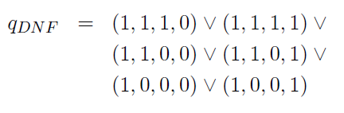
The Boolean Model
This approach works even if the vocabulary of the collection includes terms not in the query
Consider that the vocabulary is given by
Then, a document dj that contains only terms ka, kb, and kc is represented by c(dj) = (1, 1, 1, 0)
The query is represented in disjunctive normal form as

Slide 32
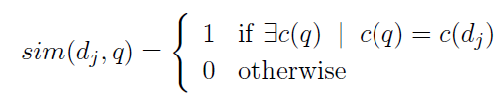
The Boolean Model
The similarity of the document dj to the query q is defined as
The Boolean model predicts that each document is either relevant or non-relevant

Slide 33
Drawbacks of the Boolean Model
Retrieval based on binary decision criteria with no notion of partial matching
No ranking of the documents is provided (absence of a grading scale)
Information need has to be translated into a Boolean expression, which most users find awkward
The Boolean queries formulated by the users are most often too simplistic
The model frequently returns either too few or too many documents in response to a user query

Slide 34
3.2.2 Term Weighting

Slide 35
Term Weighting
The terms of a document are not equally useful for describing the document contents
In fact, there are index terms which are simply vaguer than others
There are properties of an index term which are useful for evaluating the importance of the term in a document
For instance, a word which appears in all documents of a collection is completely useless for retrieval tasks

Slide 36
Term Weighting
To characterize term importance, we associate a weight wi,j > 0 with each term ki that occurs in the document dj
If ki that does not appear in the document dj , then wi,j = 0.
The weight wi,j quantifies the importance of the index term ki for describing the contents of document dj
These weights are useful to compute a rank for each document in the collection with regard to a given query

Slide 37


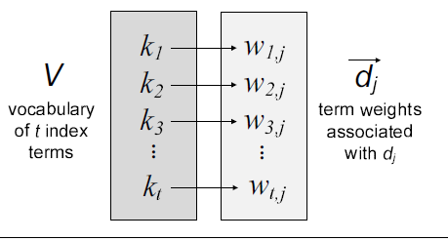
Term Weighting
Let,
ki be an index term and dj be a document
be the set of all index terms
wi,j >= 0 be the weight associated with (ki, dj)
Then we define as a weighted vector that contains the weight wi,j of each term ki V in the document dj

Slide 38

Term Weighting
The weights wi,j can be computed using the frequencies of occurrence of the terms within documents
Let fi,j be the frequency of occurrence of index term ki in the document dj
The total frequency of occurrence Fi of term ki in the collection is defined as
where N is the number of documents in the collection

Slide 39
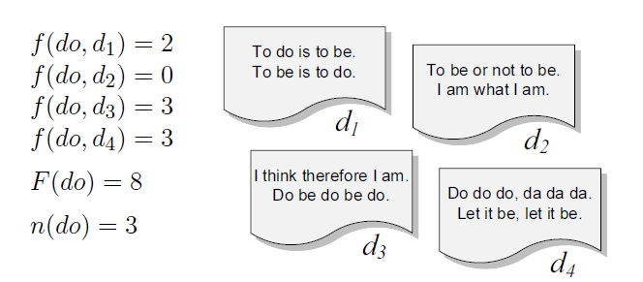
Term Weighting
The document frequency ni of a term ki is the number of documents in which it occurs
Notice that ni <= Fi
For instance, in the document collection below, the values fi,j , Fi and ni associated with the term do are

Slide 40
Term-term correlation matrix
For classic information retrieval models, the index term weights are assumed to be mutually independent
This means that wi,j tells us nothing about wi+1,j
This is clearly a simplification because occurrences of index terms in a document are not uncorrelated
For instance, the terms computer and network tend to appear together in a document about computer networks
In this document, the appearance of one of these terms attracts the appearance of the other
Thus, they are correlated and their weights should reflect this correlation.

Slide 41
3.2.3 Document Length Normalization

Slide 42
Document Length Normalization
Document sizes might vary widely
This is a problem because longer documents are more likely to be retrieved by a given query
To compensate for this undesired effect, we can divide the rank of each document by its length
This procedure consistently leads to better ranking, and it is called document length normalization

Slide 43
Document Length Normalization
Methods of document length normalization depend on the representation adopted for the documents:
Size in bytes: consider that each document is represented simply as a stream of bytes
Number of words: each document is represented as a single string, and the document length is the number of words in it
Vector norms: documents are represented as vectors of weighted terms

Slide 44


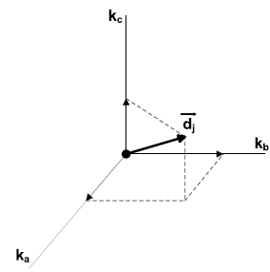
Document Length Normalization
Documents represented as vectors of weighted terms
Each term of a collection is associated with an orthonormal unit vector in a t-dimensional space
For each term ki of a document dj is associated the term vector component

Slide 45

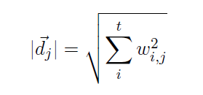
Document Length Normalization
The document representation is a vector composed of all its term vector components
The document length is given by the norm of this vector, which is computed as follows

Slide 46
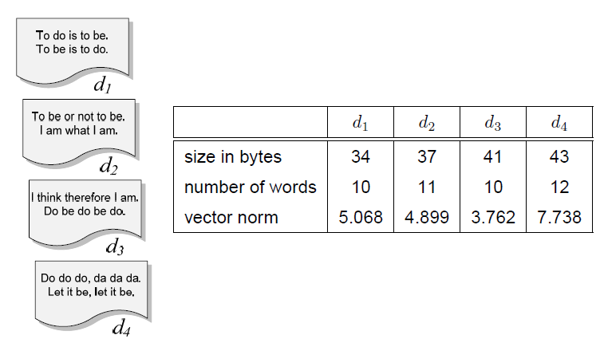
Document Length Normalization
Three variants of document lengths for the example collection

Slide 47
3.2.4 The Vector Model

Slide 48
The Vector Model
Boolean matching and binary weights is too limiting
The vector model proposes a framework in which partial matching is possible
This is accomplished by assigning non-binary weights to index terms in queries and in documents
Term weights are used to compute a degree of similarity between a query and each document
The documents are ranked in decreasing order of their degree of similarity

Slide 49
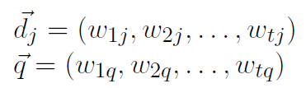
The Vector Model
For the vector model:
The weight wi,j associated with a pair (ki, dj) is positive and non-binary
The index terms are assumed to be all mutually independent
They are represented as unit vectors of a t-dimensionsal space (t is the total number of index terms)
The representations of document dj and query q are t-dimensional vectors given by

Slide 50
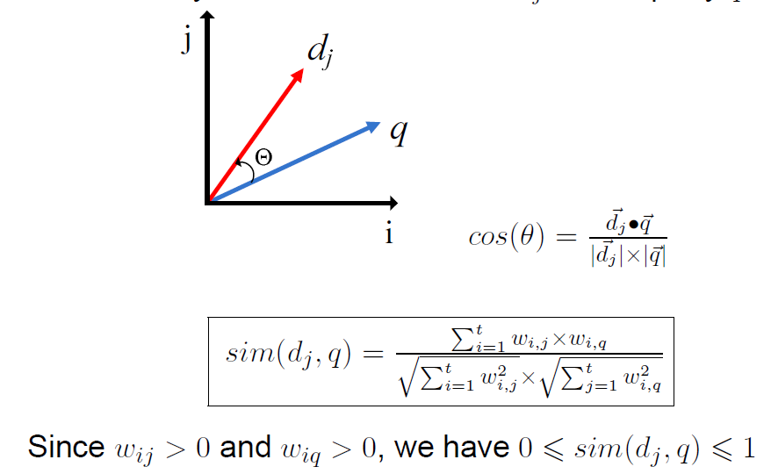
The Vector Model
Similarity between a document dj and a query q

Slide 51
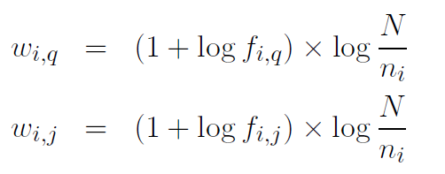
The Vector Model
Weights in the Vector model are basically tf-idf weights
These equations should only be applied for values of term frequency greater than zero
If the term frequency is zero, the respective weight is also zero

Slide 52
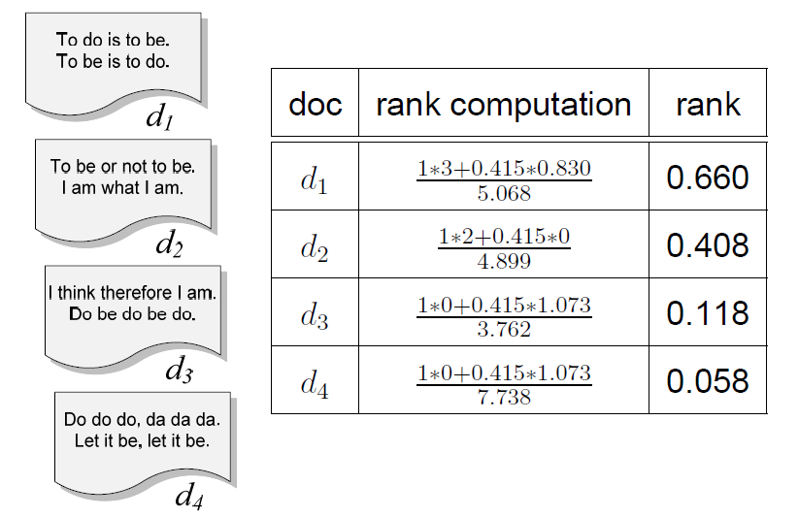
The Vector Model
Document ranks computed by the Vector model for the query “to do”

Slide 53
The Vector Model
Advantages:
term-weighting improves quality of the answer set
partial matching allows retrieval of docs that approximate the query conditions
cosine ranking formula sorts documents according to a degree of similarity to the query
document length normalization is naturally built-in into the ranking
Disadvantages:
It assumes independence of index terms

